Slide 1

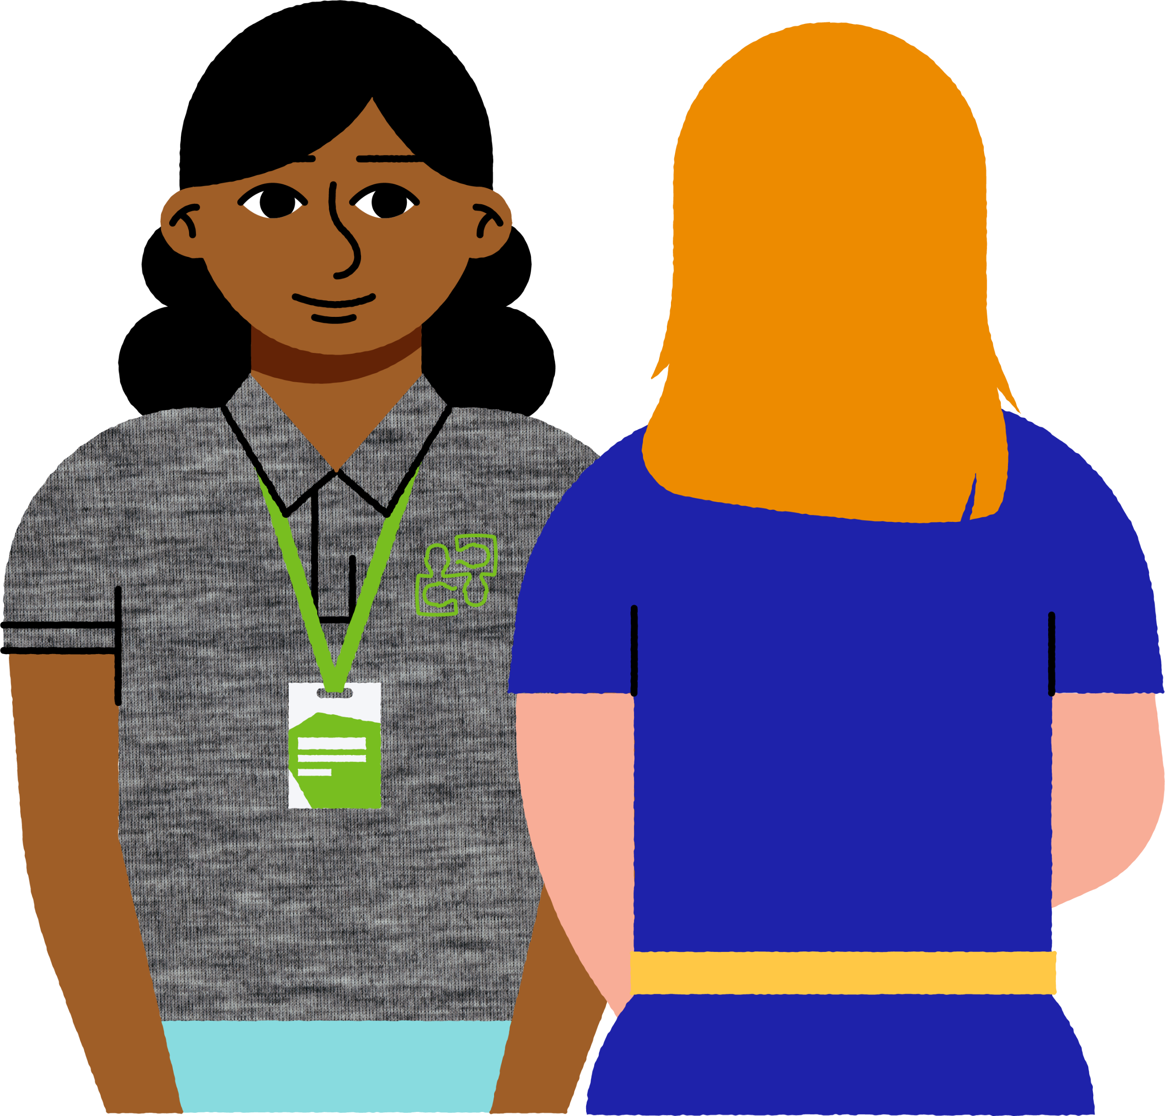


Life after
Secondary School
A guide to navigating the pathways
into adulthood
Brought to you by:
Last updated: September 2025. This document is only as relevant as the date printed prior. Information is subject to change.

Slide 2

Acknowledgements
We would like to acknowledge those who supported the development of this document: the headspace Casey and Cardinia Community Engagement Team in consultation with the Youth Advisory Committee and young members from the Cities of Casey and Cardinia. Thank-you for your hard work and ongoing commitment to the local community.

Slide 3

Contents
What is the Purpose of this document? – Page 4
Employment – Page 6
“I went straight into employment” – Page 7
Volunteering – Page 8
“My experience as a volunteer” – Page 9
Traineeships – Page 10
Still Unsure? – Page 11
“I’m still figuring it out” – Page 12
Gap Year – Page 13
“I took a gap year“ – Page 14
Year 10, Year 11 and Year 12 preparation for further studies – Page 15
Pre-University and TAFE Entry Requirements – Page 23
TAFE Pathway – Page 29
“I chose a TAFE pathway“ – Page 30
University Pathway – Page 35
“My University Experience”– Page 36
Financial Support – Page 41
Skills and Job Support – Page 46
How can headspace help? – Page 47
General Information – Page 51
Open Days – Page 53
Handy Websites – Page 55
References – Page 56

Slide 4




What is the purpose of this document?
Navigating life outside of school can be daunting and difficult. It is hard to know where to begin to find support.
This document serves as a guide to the post school options available to you.
It is a summary of key information to support you on your post school journey.
This document is a
good starting point with
lots of helpful pointers
to guide you.
Use the links and
visit the websites listed
to find out more
and take steps
towards your future.
You can use the contents page to skip to sections of interest or search for specific topics. Listed websites are also hyperlinked for easy access.

Slide 5


Where to next?

Slide 6

Employment
There are jobs that do not require tertiary (degrees, diplomas etc) qualifications.
Some jobs may even provide training once in the role.
The number of young people seeking employment directly after school continues to grow.
Useful sites to visit if you are looking for employment are:
  Indeed
  SEEK
  LinkedIn
You can always apply to further study, whether it is TAFE or University, at any stage of life.

Slide 7
“I went straight into employment”
We asked a local young person who when straight into employment their thoughts
Going straight into work has allowed me to...
  -Gain invaluable real-life experience.
  -Develop practical skills, adapt to professional settings and navigate real-world challenges through a
  hands-on approach I didn’t get from the classroom.
The people / resources / services that helped me decide to go straight into employment were…
  -Myself. I made the decision to pursue employment on my own. I didn’t have any guidance from external services
  or supports as I knew what I wanted to do.
A little advice for those considering entering the workforce straight after school is…
  -Take your time and do plenty of research.
  -Seek guidance from local services or career advisors.
  -Explore your interests and goals thoroughly so you feel confident, and happy with your decision.
  -Being prepared makes all the difference.
What I wish I had known about going straight into work is...
  -The transition can feel heavy. Taking on adult responsibilities was overwhelming for me.
  -Exploring options can be helpful. I didn’t take the time to explore other options that might have better suited
  me or my goals.
  -It is important to take the time, weigh your choices and understand what is best for you.
A young person from Cardinia Shire

Slide 8

Volunteering
Volunteering is unpaid work.
Volunteering is a way to gain real-world experience, build your network and meet people.
Volunteering can help you build transferable skills and get industry experience.
Australian Volunteers is a website that will display any volunteer opportunities.

Slide 9

“My experience as a volunteer”
Volunteering has allowed me to...
  - Make new connections and build my professional network.
  - See what my professional field of interest looks like.
  - Make new friends.
  - Understand why community is important.
A little advice for those considering volunteer work…
  Do not expect paid employment as an outcome of your volunteering.
  The role is not any less valuable because it is unpaid.
  Your professionalism is what will leave an impression.
  You don’t have to say yes to everything but try to say yes to at least half of the opportunities offered.
  Be respectful towards your facilitators/mentors/supervisors because they could become a great reference.
What I wish I had known about volunteering is...
  - How fun it would be.
  - That it will support your career. It could lead to employment and will help you to gain insight into the field
  you are interested in
A young person from Cardinia Shire

Slide 10
Traineeships
Traineeships are on the job training. It combines work experience with training at a Registered Training Organisation.
They usually take 1-2 years. This differs depending on the qualification.
Traineeships allow you to earn a wage while you study.
There are a wide range of qualifications and career options that offer a traineeship.
You can find traineeships by searching platforms like SEEK or organisations will have them listed on their careers’ page on their websites.

Slide 11

Still unsure?
If you are undecided about the path you want to take, this page is for you.
Which pathway to take in adulthood is a big decision. It is understandable that you may not be sure whether employment, study or travel is the best way forward. You are entitled to take some time to just be, consider your options and work on yourself.
If you do not go to university or TAFE straight out of high school, you can apply later. You will be a mature aged student.
If you want to attend university after some time away from study, you will need to apply directly and provide a personal statement. The university may review your ATAR score and consider other life experience you may have (work, volunteering etc) before offering you a place. You do not have to meet the same requirements as those applying straight out of high school.
A personal statement is like a cover letter but for studying. You will need to provide information about yourself, past employment, education history, and explain why you want to complete this course.
TAFE courses entry requirements remain the same whether you are mature aged or not. These requirements differ depending on the qualification.

Slide 12

“I’m still figuring it out”
We asked a local young person who is not currently working or studying their thoughts
Taking a break has allowed me to...
  -Reflect on myself.
  -Prioritise my health and wellbeing.
The people / resources / services that helped me decide to take a break after school were…
  -My family. They were supportive and allowed me to figure out my own path.
  -Centrelink. They helped me explore available financial options.
A little advice for those considering a break after school is…
  -You do not have to please others.
  -Take things at your pace.
What I wish I had known about taking a break before I committed to it is...
  -People may ask questions about your decision and struggle to understand
  why I chose it.
A young person from the City of Casey

Slide 13

Gap Year
A gap year is a year off academic study.
Typically, it is taken straight after secondary school.
You can take a gap year off to work, travel, volunteer or just be.
It can be a way to meet people, experience different things and learn new skills.
Year 13 is an organisation that helps young people navigate life after school.
They have a list of gap year providers and a career quiz you can take.

Slide 14

“I took a gap Year”
We asked local young people who took a GAP year their thoughts
What I wish I had known about taking a gap year before I committed is...
  -That returning to university after some time off can be quite challenging.
  -You may come back to study with a different mindset after exploring new passions.
  -It may be the breather you need before entering a new chapter sooner than you should.
The people / resources / services that helped me decide to take a break were…
  -My peers. They helped me to figure out if the degree I initially completed was the right path.
  -My mental health. I needed to consider how I was coping and allow myself time to relax before considering
  what field I was interested in.
  -The degree I had just completed. I realised I was not interested in the common career path that stemmed
  from my degree. I needed a break to reflect on what type of career I saw myself in and how to get there.
The things you enjoyed the most about taking a gap year were…
  -The ability to spend time with parents and friends.
  -The relaxed environment and ability to think in the present.
  -Figuring out more about who I am and what career I want to pursue.
Because I took a gap year, I have/am…
  -More at peace with myself, and I am kinder to my mental health.
  -Harboured a positive approach toward my future.
  -Felt a little behind at times. However, I know there is no set timeline for your future, and I must
  do what is best for me.
Young people from the City of Casey

Slide 15


Year 10
Year 11
Year 12

Slide 16

Vocational Education and Training (VET)
VET develops skills required for training, employment and further studies with the addition of industry specific skills.
VET can be completed within VCE, VCE VM or VPC (please see details of these on pages 17-18, 19-20, and 21-22 respectively).
Some units completed in VET count towards a nationally recognised VET certificate.
Some VCE VET courses can count towards your ATAR.
Your school should provide details on this. You can also visit the Department of Education website for further information.

Slide 17

Victorian Certificate of Education (VCE)
VCE is the most common pathway out of high school in Victoria.
This pathway is recognised internationally.
You can continue to study at TAFE, university or another VET provider upon VCE completion.
Students undertaking VCE subjects will have to complete a General Achievement Test (GAT). Your school should provide details on this. You can also visit the Department of Education website for further information.
You can complete VCE scored (which requires you to sit your exams and then receive an ATAR) or unscored (which requires you to complete and pass SACs but do not sit exams or receive an ATAR)

Slide 18

VCE Continued.
To complete your VCE, you will need to complete Units 1, 2, 3 & 4 of 5 – 6 subjects.
You can choose which subjects you want to complete based on what your schools offer.
English is always a requirement, but your school may offer more than one English subject.
Units 1 & 2 are typically completed in Year 11 and Units 3 & 4 are typically completed in Year 12.
Some schools may allow you to undertake a VCE class in Year 10 – meaning you will finish this subject at the end of Year 11. Your school should provide details on this. You can also visit the Department of Education website for further information.

Slide 19
VCE Vocational Major (VM)
Like going unscored, you do not have to sit exams with this pathway unless you choose to go scored.
VCE VM is a new study pathway offered in most schools.
In choosing this pathway, you will study numeracy, literacy, work skills and personal development.
To complete this pathway, you will need to complete a minimum of 180 hours of VET.
This option is suitable for those who like to learn in real-world environments.

Slide 20

VCE VM Continued
A VCE VM can prepare you to study further, start an apprenticeship or traineeship or straight into employment.
You will need to complete:
  3 VCE VM Literacy or VCE English
  2 VCE VM Numeracy or VCE Maths
  2 VCE VM Work Related Skills
  2 VCE VM Personal Development Skills
  3 other VCE units of your choosing
  VET Certificate level 2 or above
Your school should provide details on this if this study option is available. You can also visit the Department of Education website for further information.
VCE VM has replaced the Victorian Certificate of Applied Learning (VCAL).

Slide 21

Victorian Pathways Certificate (VPC)
This pathway is a foundation course for students in years 11 and 12 who are not ready or able to complete VCE.
This pathway prepares you for VCE, VCE VM or entry level VET or employment.
This pathway has been designed to be accessible for students.
If this is a pathway you want to explore, it is encouraged for parents/guardians/carers to speak to your school regarding eligibility.

Slide 22

VPC Continued
This is a flexible certificate for students, and your school may allow you to start during any point of the school year. This pathway allows flexibility for duration of course.
In this pathway, you can also complete VET and VCE units.
You will study numeracy, literacy, work skills and personal development skills.
Your school should provide details on this. You can also visit the
Department of Education website for further information.

Slide 23

Pre-University and TAFE Requirements

Slide 24

What are prerequisites, study scores
and ATAR requirements?
Prerequisites are requirements for tertiary courses. Most courses need you to have completed certain subjects and to have obtained above a certain study score to be accepted. A variant of any English subject is typically a prerequisite for all courses.
A study score is provided for each subject you studied in year 12. It is determined by the marks you received for SACs, exams, practicals, and assessments throughout the year. It is out of 50.
There are raw scores and scaled study scores. Raw scores are what you get before any scaling happens. Scaled scores are based on how difficult or common a subject is. It can either increase or decrease your raw score.
An ATAR (The Australian Tertiary Admission Rank) is scaled between 0.00 to 99.95. It is based on your position in comparison to other year 12 students that year.
Up to six (6) subjects are counted towards your ATAR, two (2) of which only count for 10% each. It is usually your lower scoring subjects that count towards the 10%. A variant of English is always included in your top four (4) subjects.

Slide 25

TAFE Entry Requirements
TAFE entry requirements will be based on age restrictions as well as the completion of a Basic Key Skills Builder (BKSB) assessment. Admission emails will have instructions on how to book these assessments.
Minimum age requirements are also required for placement, and there will be situations where a parent agreement is required for those under 18 years.
Some courses will require you to be enrolled in VCE or VCE Vocational Major (VM) throughout the course as well. Some courses also require a valid volunteer Working with Children’s Check.
All information regarding entry requirements are on the webpage of your desired course at your desired institute.

Slide 26

Special Entry Access Scheme (SEAS)
SEAS is also known as special consideration. It is for university. It helps institutes better understand your circumstances and how this may have impacted your studies. It helps your application become more competitive.
There are four (4) categories:
  Category 1: Personal information and background
  Category 2: Disadvantaged financial background
  Category 3: Disability or medical condition
  Category 4: Difficult circumstances
Examples of what qualifies include: residential location, Centrelink recipient, mental health conditions
and difficult family circumstances.
Please note, SEAS does not change your ATAR. Some of the eligibility criteria differs each year. For example, schools that are underrepresented at university’s change year by year, therefore the graduating class above you may qualify for SEAS,
but your class may not.

Slide 27

What do I do if I don’t meet my course requirements?
There are always pathways to get to the course you desire. Some pathways may take longer than others.
Different pathways include:
  Applying to a different university with different requirements
  Applying to a similar course or double degree course and transferring over
  Applying to an online university and transferring to a campus-based course the following year
  Completing diplomas or other courses first and using Recognition of Prior Learning to transfer to university once complete
  A career counsellor can help you navigate/prepare for situations such as these. Contact your institute for more tailored advice.

Slide 28

Specialised career pathways
There are some educational institutions that specialise in certain career paths.
For example:
  The Australian College of Agriculture and Horticulture
  LCI Education (formerly Australian Academy of Design)
  The National Institute of Dramatic Arts
These institutes offer degrees, diplomas and short courses. Look online for institutes that align specifically with your interest area for more details.

Slide 29

TAFE Pathway

Slide 30

“I chose a TAFE pathway”
We asked local young people who are enrolled at TAFE their thoughts
Because I chose the TAFE pathway…
  -I was able to enter the 2nd year of my university course due to recognition of prior learning.
The people/resources/services that helped me choose the TAFE pathway were…
  -Open Universities Australia.
  -Online search engines that helped to showcase courses nearby.
The things that I have enjoyed most about TAFE are…
  -Smaller classes which means more individual attention and interpersonal connections.
  -The casual environment.
  -The flexibility.
What I wish I had known about TAFE before I committed was…
  -What pathways were available before committing financially .
  -The difference between Commonwealth Supported Place (CSP) and Higher Education
  Contribution Scheme (HECS), Higher Education Loan Program (HELP) and
  how the debt works.
Young people from the City of Casey

Slide 31

TAFE
TAFE stands for Technical and Further Education.
There are over 15 TAFEs in Victoria, two of which are also University’s (RMIT and Swinburne are classified as both). There are over 80 TAFE campuses in Victoria.
There are multiple campuses for certain TAFEs, offering locations both in regional and metropolitan areas.
Some TAFE courses can be done online. Search your desired institute followed by ‘online study’
to see if they offer this option.

Slide 32

TAFE Qualifications
Each institute offers different qualification options.
You can obtain the following qualifications via TAFE:
  Diplomas
  Advanced Diplomas
  Bachelor's Degrees
  Certificates
  VET (Vocational Education and Training)
  VCE (Victorian Certificate of Education)
  VCE VM (Victorian Certificate of Education Vocational Major)
Some TAFEs offer diploma to degree pathways.
Search which institute you are enrolled in/want to enrol in to find what qualification options and pathways they offer.

Slide 33

TAFE and Secondary School
TAFEs offer opportunities for you to study while at secondary school.
While you are studying at secondary school, you need to be available to attend Vocational Education and Training (VET) days at TAFE to ensure you can complete both areas of study.
Please check with your desired TAFE and school to see if this is an option for you. Search your desired institute followed by ‘Secondary Students Program’ or alike for more details.
Discuss this with your school coordinator, career counsellor, guidance counsellor or any support staff available at your school to determine if this option can be organised.

Slide 34

Apprenticeships
Apprenticeships allow you to earn money while you learn a trade and work towards an accredited qualification.
You must be of working age to begin an apprenticeship, and they usually last 3-4 years.
There are options to completing an apprenticeship. These include:
  Full-time
  Part-time
  School based
Visiting the Australian Apprenticeships Pathways website can provide tools and resources to assist you with this career choice.
Apprenticeship Support Australia is another website to explore for options and opportunities.

Slide 35

University Pathway

Slide 36

“My University Experience”
We asked local young people who are enrolled at University their thoughts
1. Because I chose the University pathway…
  -I had opportunities offered to me through my connection to the University.
  -I had the opportunity to volunteer and complete an internship.
  -I am more informed about the different aspects of a degree.
2. The people/resources/services that helped me choose the University pathway were…
  -Career Counsellor
  -Parents
  -Teachers
  -Career Expos
  -Subjects at school that linked to my desired degree
3. The things that I have enjoyed most about University are…
  -How broad career opportunities are
  -The structure of my course
  -The ability to Network
  -The facilities that expose me to machines and technology I will encounter in the work force
4. What I wish I had known about University before I committed was…
  -The HECS debt
  -The length of the course
  -The strict criteria to continue postgraduate studies
  -The high amount of independent learning
Young people from the City of Casey

Slide 37

University
There are main campuses for University and satellite campuses. A satellite campus is a branch of a university that has a main campus. For example, Deakin University's main campus is Geelong Waurn Ponds, their satellite campuses are
Geelong Waterfront, Burwood, and Warrnambool.
Victoria has 51 university campuses with 34 of these in metropolitan Melbourne.
There are universities in other states that offer online courses for interstate students. There are also universities that operate strictly online.

Slide 38

Preparing for University
University courses are going to have prerequisite subjects, study scores and ATAR requirements.
They will typically have Unit 3 and 4 prerequisites. Make sure you are completing the subjects you need for your desired course/s.
If your school has opportunities to select electives in Year’s 9 and 10, it can be a good time to try subjects that you might consider as a career path.
Schools should have career or guidance counsellors; it is worthwhile booking in to see them. Alternatively, there are external career counsellors, but they may charge a fee.

Slide 39

What is Recognition of Prior Learning?
Recognition of Prior Learning (RPL) takes into consideration the knowledge and skills you have.
This may have been obtained through completing another course, general life experience, employment or volunteering. Universities consider this when you apply for a course to determine if your RPL will assist with the training requirements needed to complete it.
If you transfer or apply for a course, RPL may be applied if you have completed similar or the same units previously. This will mean you do not have to repeat that unit.
You need to enquire about RPL at enrolment and before the census cut-off date. If you are eligible, your RPL will be added to your overall credit points tally. A certain number of credit points are required to complete a course.
Please note, some institutes may not recognise some study completed overseas. If you want to study abroad during your degree, investigate how your institute can support you.

Slide 40


I play sport at an elite level. I also want to study. Can I do both at the same time?
Many universities have their own versions of an
‘Elite Athlete Program’. Search your university,
or your desired university online followed by
‘Elite Athlete Program’ for more details.
Elite Athlete Programs can provide a range of support for athletes. This can include managing your workload, course and planning advice, special consideration for due dates, assignments, exams, or even absences.
Please note support may differ between institutions.
Nothing showed up on your search?
If you are struggling to find the right information, email your university to see if such a program exists. There may be other plans and support systems you qualify for, and student coordinators or course advisors can point you in the right direction.

Slide 41
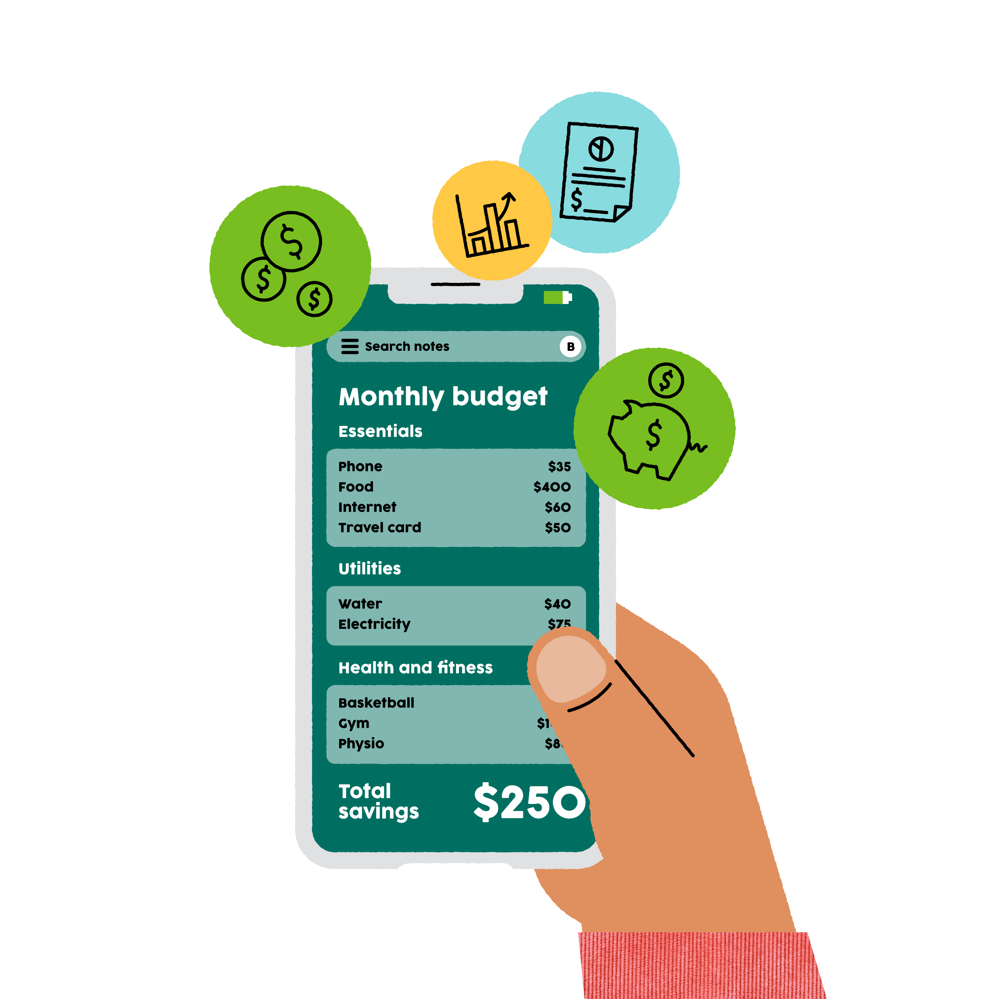
Financial Support

Slide 42
HECS-HELP and other study loans
HECS stands for Higher Education Contribution Scheme and HELP stands for Higher Education Loan Program.
HECS-HELP loans are available for most people when studying at university. There is eligibility criteria to qualify for these loans, as well as course requirements. A common criteria is you must be studying in a Commonwealth Supported Place (CSP).
A CSP is a government approved higher education provider. The Australian Government pays part of your fees in a CSP. The rest of your fees either need to be paid up-front, or through HECS-HELP loans.
HECS-HELP loans are the same as any loan, they generate interest. You must start paying these loans when you earn a certain amount. You must tell your employer if you have a HECS-HELP loan so they can make payments for you once you reach this threshold. You can also make voluntary payments through the Australian Tax Office (ATO).
If you do not qualify for HECS-HELP loans, you will either need to pay up front before the census date or explore other loan options.
The Australian Government Study Assist website has information on other loan types.

Slide 43
I am moving to study.
What support can I get?
There are services that financially support those relocating for study.
Services Australia is a great website to use to determine the specific support you are eligible for.
There is a Tertiary Access Payment for those who live in rural or remote areas and are moving for tertiary study (university, TAFE, college).
There is eligibility criteria for the Tertiary Access Payment. This includes that the payment can only be used if you move within 12 months of finishing Year 12 or equivalent.
Tertiary Access Payment is a once-off payment.
Search ‘Tertiary Access Payment’ on Google or browse the Services Australia website for more details.
Don’t live in a rural or remote area?
Browse the Service Australia website to discover if there is any payment you qualify for.
One may be Youth Allowances for students and Australian Apprentices. This does not specify that you need to be from rural or remote communities. For this support, you must be living in Australia and be an Australian resident.
Check out the next page for further details.

Slide 44
Student or Apprentice Allowance
There is Youth Allowances for Students and Australian Apprentices. Details can be found at the Services Australia website.
You must be:
  18-24 years of age studying full-time
  16-17 years of age studying full-time AND independent or living away from home for study
  16-17 years of age studying full-time AND have completed year 12 or equivalent
  16-24 years of age and a full time Australian apprentice
What you need:
  Supporting documents such as:
  -Tax File Number (TFN) -bank account details
  -superannuation account -proof of independence eg: living arrangements (address)
  -proof of employment OR study -medical and relationship details
A parent, guardian or partner may need to provide information too.
The Services Australia website has steps on how to prepare and how to claim this allowance.
For further financial support, investigate the Service Australia website.

Slide 45
What Scholarships can I apply for?
A scholarship is subsidised financial support awarded to students for either academic success or other achievements.
There are many kinds of scholarships available with various eligibly criteria.
Study Australia has a lot of information on the various scholarships available and links on how to enquire/apply.
You can also search the institute you want to apply for/are enrolled in and see the scholarships that they have available.
You can also check the Victoria Tertiary Admissions Centre (VTAC) website for scholarships.
There are also scholarships available through the Victorian Department of Education and Training.

Slide 46
Skills and Job Support
Each university and TAFE should have their own supports available for current students and alumni to explore skills and job opportunities. Search your institute followed by what it is you are after.
  E.g. ‘Monash University Resume Building’
  E.g., ‘Holmesglen Skills and Job Centre’
One example is Chisholm TAFEs Skills and Jobs Centre. This runs weekly and fortnightly workshops on topics like resume building, interview skills, an introduction to Australian employment and networking. You do not have to be enrolled at Chisholm to attend.

Slide 47

How can headspace help?

Slide 48
headspace Support
headspace Narre Warren collaborates with WISE employment to provide work and study support.
A WISE employee works onsite on a fortnightly basis.
There is online work and study support for 15–25-year-olds through headspace National. This service is offered for approximately three months and provides video or phone appointments for 30-60 minutes.
There is career mentoring available online through headspace National. This is for 18–25-year-olds.
This service offers 30–60-minute video appointments for up to six months.
A headspace Centre workforce may include vocational workers to support you. Reach out to your local centre for more information.
headspace Narre Warren and Pakenham have Peer Support Workers (young people with lived experience of mental health challenges) who can support young people to discuss their work and study options, develop study skills and practice interview skills among other things.

Slide 49
headspace Support cont.
According to the headspace National Youth Mental Health Foundation in 2022-2023, 86% of young people said they would recommend headspace Work and Study to their peers.
headspace National offer fortnightly peer group chats on Thursdays. They discuss anything to do with work and study and share supports and information with each other. Check it out via the link below.
https://my.headspace.org.au/online-communities/1306968/
headspace National offers monthly professionally led group chats that discuss specific topics relating to work and study. They allow you the opportunity to submit questions in advance for consideration. Use this link to find out more https://headspace.org.au/online-and-phone-support/join-the-community/chats-by-professionals/
Browse headspace Nationals website for different articles and information about the support available
https://headspace.org.au/explore-topics/for-young-people/work-and-study/
If you have any concerns or questions, you can always talk to your headspace worker, and they can assist and point you in the right direction.

Slide 50
Information available on headspace Nationals website
Budgeting, tax and superannuation
Career planning
Education pathways
Job interviews
Job search
Mental health at work
Mental health while studying
Resumes and cover letters
Skills for the workplace
Study tips

Slide 51

General Information

Slide 52




Course Seeker
It is a useful website that allows you to search and compare thousands of courses across Australia
It will show you courses including Diplomas, Degrees and Graduate Certificates.
It is not an exhaustive resource.
It is more university focused, but there are some TAFE options available on the site.
There are currently over 140 providers listed on this website.

Slide 53

Open Days
Open Days are run by training institutions so you can visit their campuses and see their facilities. They can be anytime from March to September.
Open days allow you to talk to current students, see the campus, explore facilities offered and meet staff.
Visit the My Future website for information about tertiary institutes open days.
If you want to visit a specialized training institution, search the area of study, e.g., ‘Performing Arts’ or the name of the institute for details about open days.

Slide 54

I am not enrolled anywhere.
How can I find out this information?
You do not have to wait for an open day to ask questions. Use the “future students” sections of the training institutes website to read their frequently asked questions or further information available. You can also email or phone the institute to speak to someone directly. If they cannot help you straight away, they will either connect you with someone who can, or they will get your details and get back to you.
Please be in touch with your team at headspace if you have any questions about our services or how we can support you.

Slide 55
Handy Websites
Myfuture
Services Australia
Study Australia
The Uni/TAFE you are interested in/enrolled in
Study Assist
VTAC
Year 13
Reconnect Program
CourseSeeker
Australian Apprenticeships Pathways
Jobs and Skills Centre
Department of Education
Apprenticeship Support
Australian Volunteers

Slide 56
References
Australian Government (2024). Services Australia. Australian Government. https://www.servicesaustralia.gov.au/
Australian Government & Tertiary Admissions Centres (2024). Course Seeker. Australian Government & Australasian Conference of Tertiary Admissions Centres. https://courseseeker.edu.au/
Australian Trade and Investment Commission (2024). Study Australia. Australian Government. https://www.studyaustralia.gov.au/
Australian Skills Quality Authority (2024). Recognition of Prior Learning (RPL). Australian Government. https://www.asqa.gov.au/guidance-resources/resources-providers/faqs/recognition-prior-learning-rpl
Department of Education (2024). Study Assist. Australian Government. https://www.studyassist.gov.au/
Department of Education (2024). Support for Students. Australian Government. https://www.education.gov.au/higher-education/support-students
Department of Employment and Workplace Relations (2024). Apprenticeships. Australian Government. https://www.apprenticeships.gov.au/
Education Services Australia Ltd (2024). My Future. Education Services Australia Ltd. https://myfuture.edu.au/
State Government of Victoria (2024). Apprenticeships & Trainees. Victorian Government. https://www.apprenticeships.vic.gov.au/apprentices-and-trainees/
State Government of Victoria (2024). Find my local TAFE. Victorian Government. https://www.vic.gov.au/find-my-local-tafe
State Government of Victoria (2024). Reconnect Program 2021-2024. Victorian Government. https://www.vic.gov.au/reconnect-program
State Government of Victoria (2024). Skills and Job Centre. Victorian Government. https://www.vic.gov.au/skills-and-jobs-centres
Unicurve (2024). List of Universities in Victoria, Australia. University Reviews. https://universityreviews.com.au/list-of-universities/victoria/
Victorian Tertiary Admissions Centre Limited (2024). Results and the ATAR. Victorian Tertiary Admissions Centre. https://vtac.edu.au/atar.html#explainer
Victorian Tertiary Admissions Centre Limited (2024). About the Special Entry Access Scheme (SEAS). https://vtac.edu.au/access/seas.html

